Slide 1


ShellBeeHaken
Internship at ShellBeehaken Ltd.

Slide 2

About
ShellBeeHaken
Founded in 2020
30+ employees
Japan Bangladesh Multinational Company
Situated in Mirpur DOHS
Works on Custom Software
Notes:
Source Image:-
https://unsplash.com/photos/fOxhlF8SCt4

Slide 3

^{Diving into Code}
Fullstack experience as Software Engineer Intern
Learning the Basics
Practicing the Codes
Making A Social Media
Working in a Real World Project
Notes:
Source Image:-
https://unsplash.com/photos/aVbR17HLZTg

Slide 4

1
2
Learning the Basics
Practicing
Html, css, Javascript, Git, Redux,MongoDb,Express,
NextJs
Created a game using,js,react,redux.
3
4
Real World Project
FullStack Toy Project
Running the server
Schema Design
API Spec Writing
API Development
UI Development
NextJs, NextAuth, MongoDb

Slide 5
Internship Timeline
Basic Learning of the technologies
Developing a FullStack project
Working in a real life project
February
March
Apr-May
Jun
July
Practicing the technologies
Debugging and running a server

Slide 6
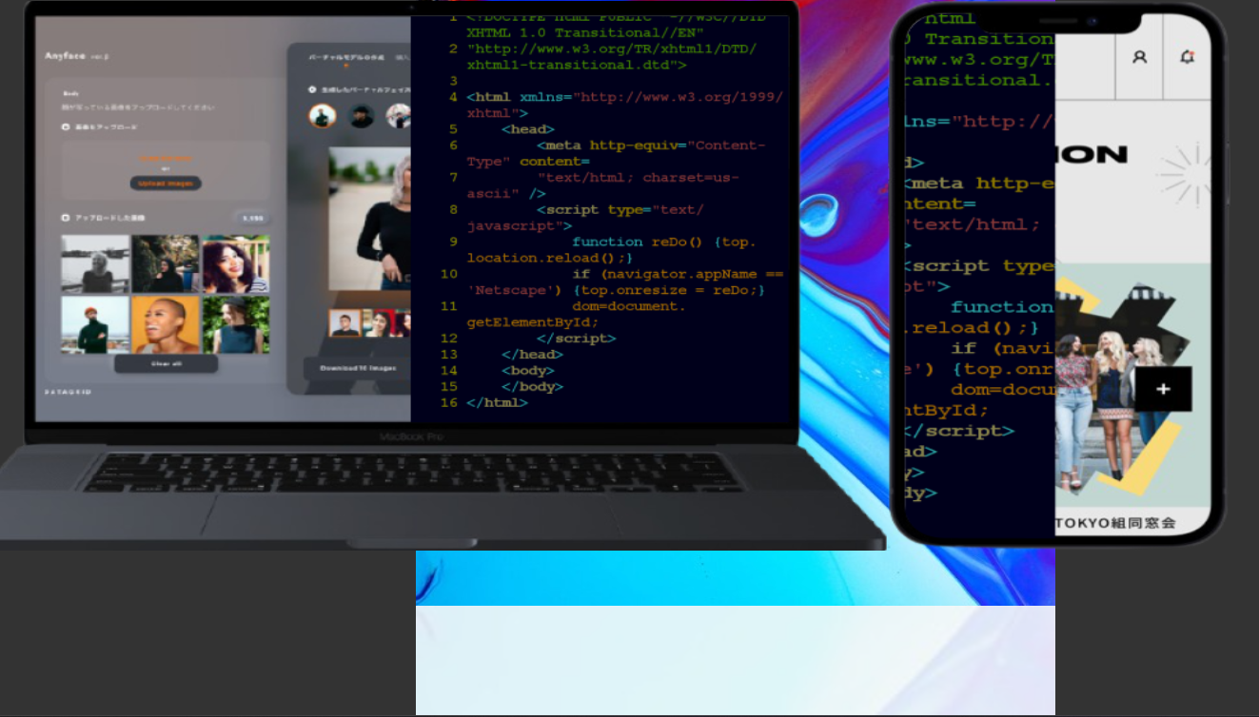
Created Only using Html, CSS and CSS Grid

Slide 7
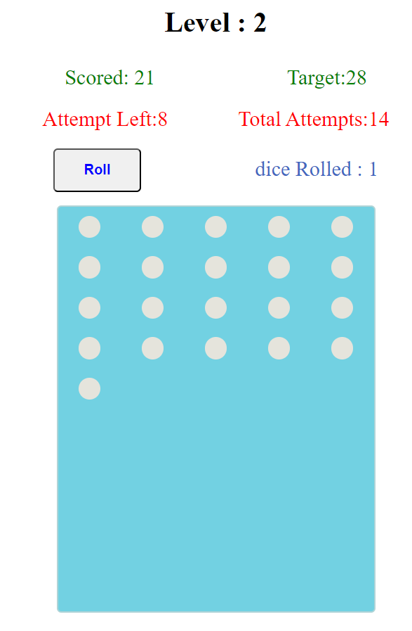
Game Created with Javascript,React And Redux

Slide 8
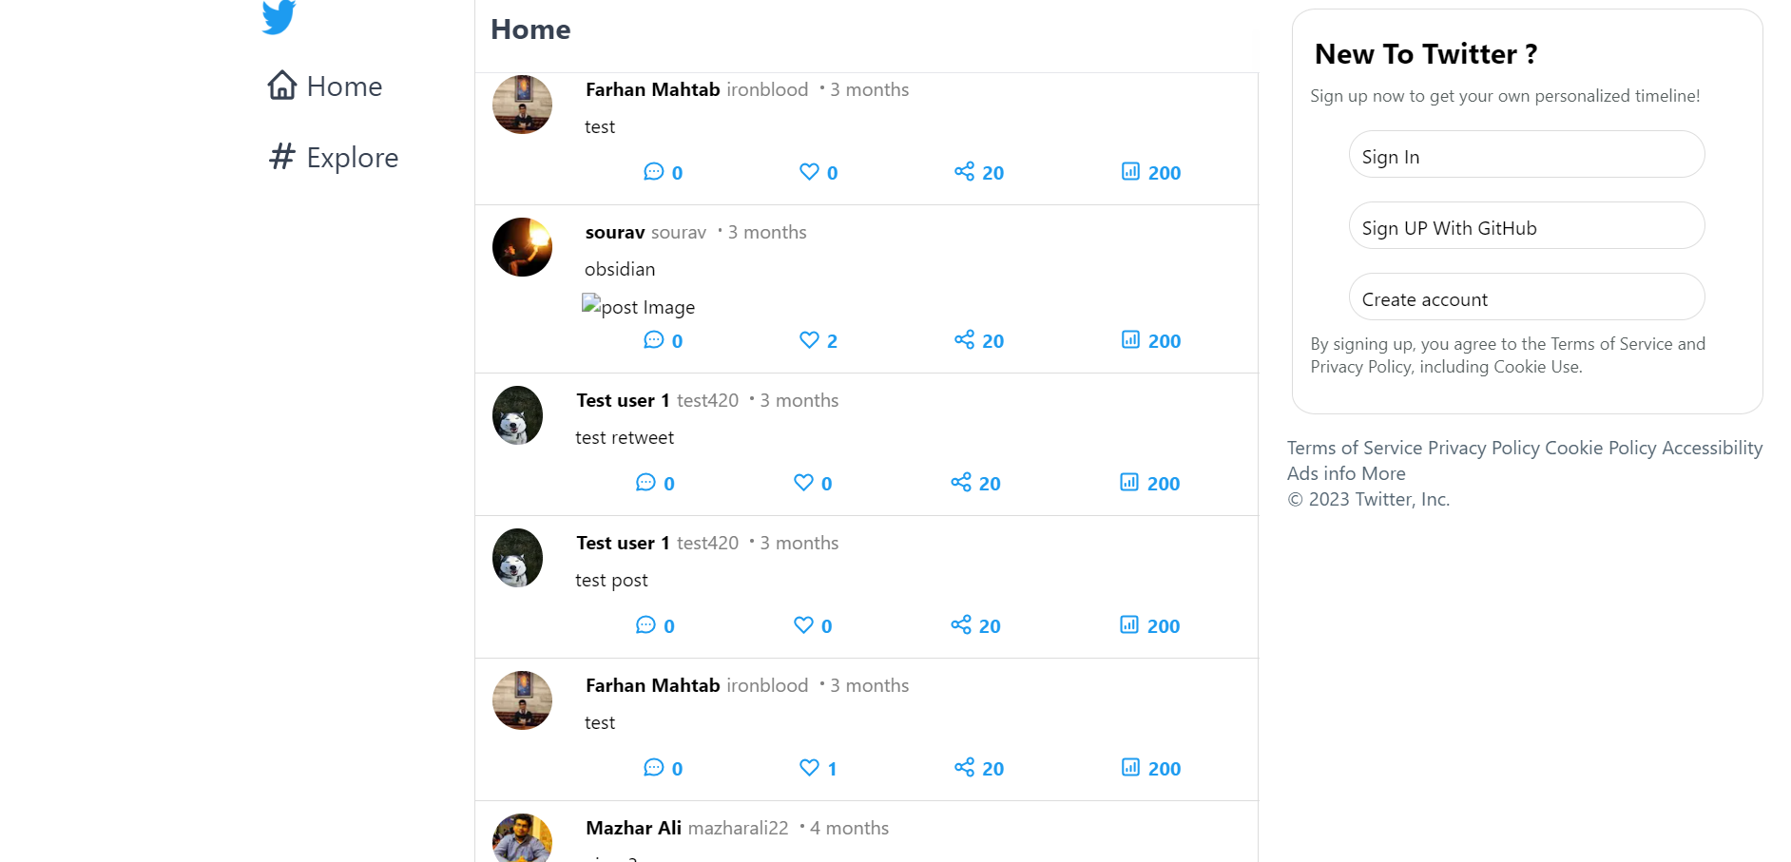
Twittter-Clone App made with NextJs and MongoDb

Slide 9
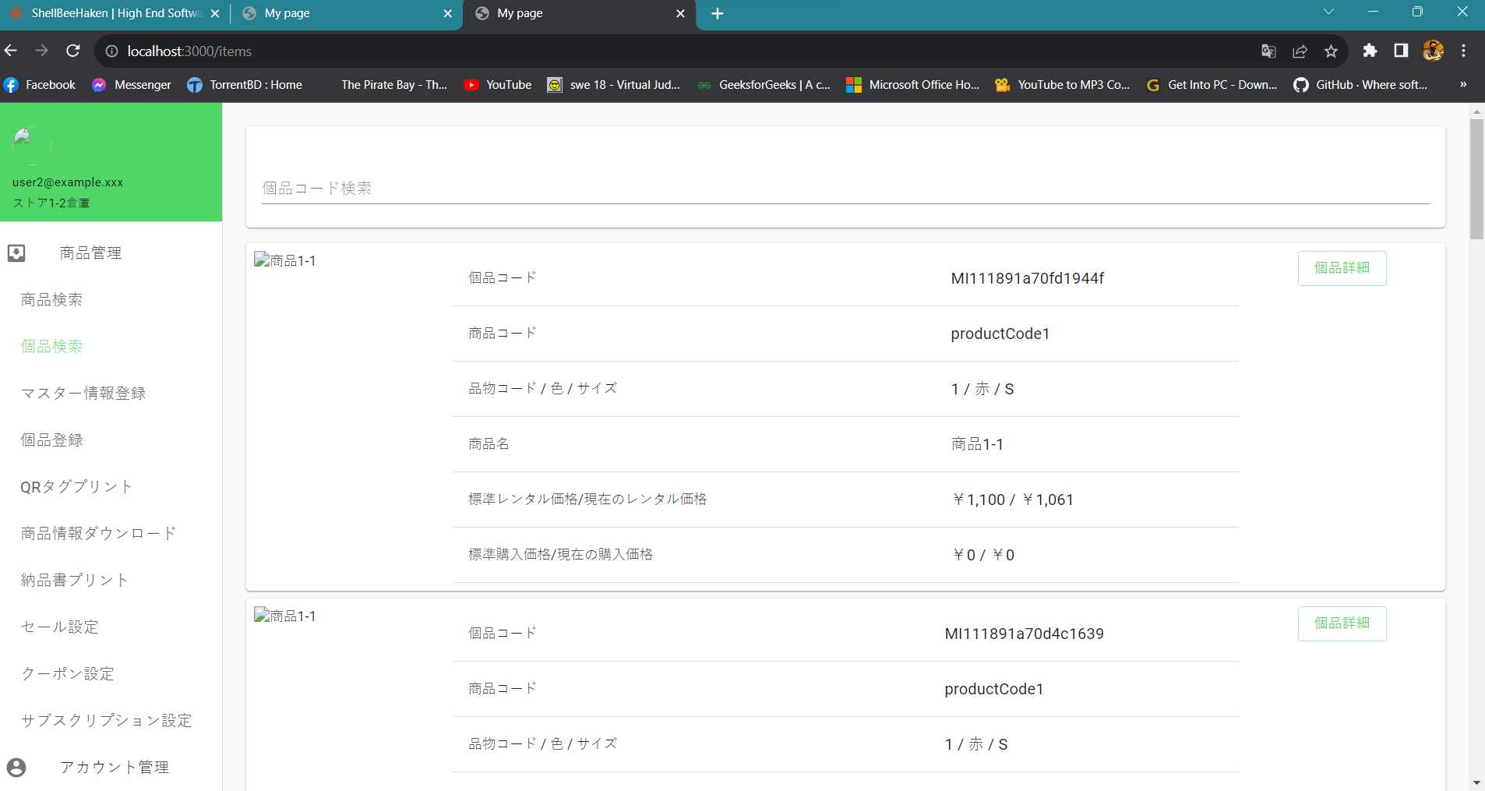
Debugged and Ran an Outdated Server
wriiten in NextJs and GraphQL

Slide 10
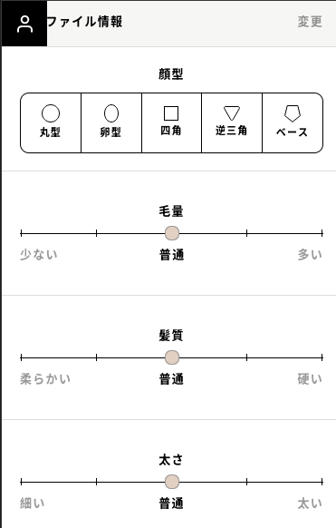
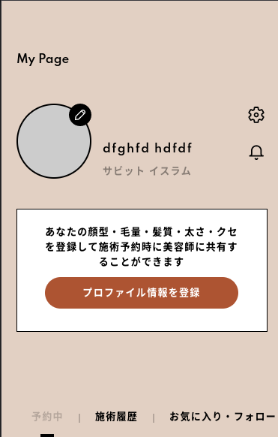
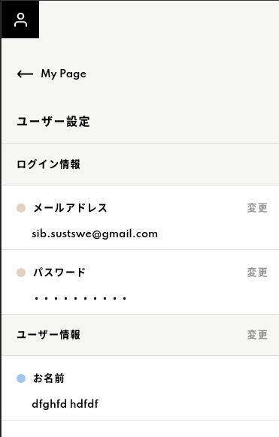
Database Design
API Specification
API Development
UI Development

Slide 11
Conclusion
Connects the Academia knowledge with the industry experience
Help to gain professional attitude, growth, maturity and judgement.
Get comfortable with uncomfortable
Experience of a lifetime

Slide 12

Do You Have Any Questions?

Slide 13
Thank You.
Farhan Mahtab Mahi
Reg:2018831036
Department of Software Engineering
IICT,SUST

